Slide 1





CYBERSECURITY

Slide 2

KEYLOGGER
A keylogger is a type of malicious software or hardware that records keystrokes made on a computer or mobile device.
It is designed to capture and log all the keys pressed by a user, including passwords, sensitive information, and other text entered.
Keyloggers can be used by cybercriminals to steal sensitive information such as login credentials, credit card details, or personal information.
Some keyloggers have advanced features, such as the ability to bypass encryption or capture information from specific applications or websites.

Slide 3
AGENDA
Project Overview
Who Are The End Users
Solution And Value Proposition
Customization To The Project
Modelling
Result
Links
Bibliography

Slide 4
PROJECT OVERVIEW
Purpose:
The primary purpose of a keylogger is to secretly capture and record keystrokes made by a user on a computer or mobile device.
Keyloggers can be used for both legitimate and malicious purposes, depending on the context and intent of their use.
Scope:
Keyloggers can target a wide range of devices, including personal computers, laptops, smartphones, and tablets.
They can capture keystrokes from various input methods, including physical keyboards, virtual keyboards, and touchscreen input.

Slide 5
Objectives:
Security and monitoring: Keyloggers can be used for legitimate purposes, such as monitoring employee activities or parental control, to enhance security and protect against unauthorized access.
Cybercrime: Malicious keyloggers are often used by cybercriminals with the objective of stealing sensitive information, such as login credentials, financial data, or personal information.

Slide 6
WHO ARE THE END USERS !?
Parents:
Characteristics: Caring parents, safety-conscious.
Needs: Monitor child's online behavior, protect from risks.
Benefit: Better visibility, identify threats, protect children.
Law Enforcement Agencies:
Characteristics: Cybercrime investigators, evidence gatherers.
Needs: Collect evidence, track online behavior.
Benefit: Keyloggers capture critical evidence, uncover patterns, support investigations.

Slide 7
Security Professionals:
Characteristics: Security professionals, auditors, analysts.
Needs: Assess vulnerabilities, detect breaches, perform forensics.
Benefit: Enhance security, identify weaknesses, improve systems.
Ethical Hackers/Penetration Testers:
Characteristics: Security experts, vulnerability testers.
Needs: Test security, find weaknesses, recommend improvements.
Benefit: Keyloggers aid in authorized testing, uncover vulnerabilities, enhance security.

Slide 8
SOLUTION AND VALUE PROPOSITION
Use reliable and updated antivirus and antimalware software.
Regularly update operating systems and software to patch security vulnerabilities.
Be cautious while downloading and installing software from untrusted sources.
Avoid clicking on suspicious links or opening attachments from unknown sources.
Use strong and unique passwords for all accounts.
Enable two-factor authentication for added security.
Be mindful of phishing attempts and avoid sharing personal information through unsecured channels.
Regularly monitor and review system logs for any suspicious activities.

Slide 9
CUSTOMIZATION TO THE PROJECT
Encryption and secure transmission: Offer encryption capabilities to encrypt the logged data and provide options for secure transmission to prevent unauthorized access.
Remote monitoring and control: Enable remote monitoring and control of the keylogger, allowing users to access and manage the logs from a remote location.
Scheduled activation: Allow users to schedule specific times or intervals during which the keylogger should be active, providing flexibility and reducing the chances of detection.
Email notifications: Implement email notifications to alert users when specific keywords or actions are detected, allowing them to be notified of potentially concerning activities in real-time.

Slide 10
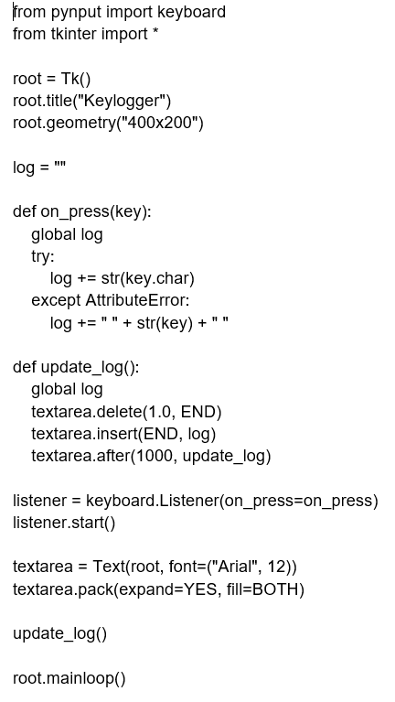
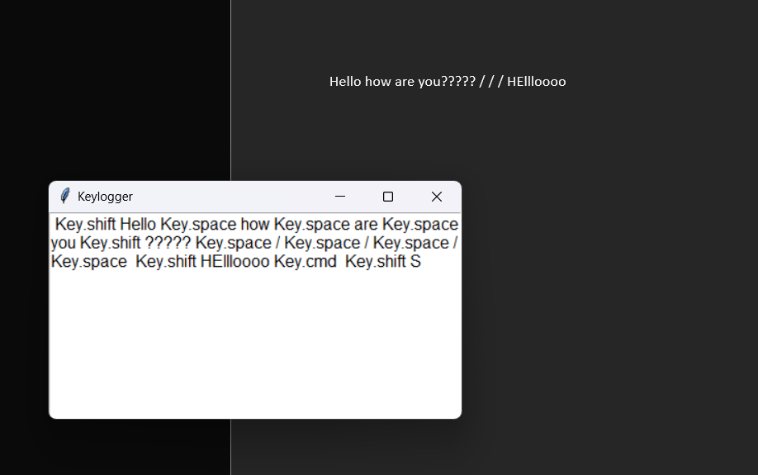
MODELLING

Slide 11
RESULT
Keystroke logging: The keylogger captured and logged all keystrokes entered by the user, including passwords, usernames, and other sensitive information.
Application usage: The keylogger tracked the applications used by the user, providing insights into their activity and preferences.
Website tracking: The keylogger recorded the websites visited by the user, enabling the identification of frequently accessed websites and online activities.
Chat and messaging logs: The keylogger captured chat conversations and messaging app activity, allowing for monitoring and analysis of communication patterns.
System monitoring: The keylogger monitored system activities such as file access, program execution, and system shutdowns, providing a comprehensive overview of user interactions with the device.

Slide 12
LINKS
https://github.com/harshakalluri14/keylogger.git

Slide 13
BIBLIOGRAPHY
https://chat.openai.com/
https://www.geeksforgeeks.org/design-a-keylogger-in-python/
https://www.javatpoint.com/creating-a-keylogger-using-python

Slide 14
THANK YOU

